Slide 1
SMART TRANSPORTATION SYSTEM
PRESENTED BY :
TEAM NAME: UNIQUE
TEAM MEMBERS:
S.APURVA
V.MADHURIMA
J.RACHANA

Slide 2
OUTLINE:
INTRODUCTION
WHY STS?
SMART TRANSPORT TECHNOLOGIES
APPLICATIONS

Slide 3
INTRODUCTION
The term Smart Transportation Systems (STS) refers to information and
communication technology, applied to transport infrastructure and vehicles, that
improve transport outcomes such as:
Transport Safety
Transport Productivity
Travel Reliability
Informed Travel Choices
Social Equity
Environmental Performance
Network Operation Resilience

Slide 4
Why STS?
Interest in STS comes from the problems caused by traffic congestion and a synergy of new information technology for simulation, real-time control, and communications networks.
Traffic congestion has been increasing worldwide as a result of increased motorization, urbanization, population growth, and changes in population density.
Congestion reduces efficiency of transportation infrastructure and increases travel time, air pollution, and fuel consumption.
Many of the proposed STS systems also involve surveillance of the roadways.
Further, STS can play a role in the rapid mass evacuation of people in urban centers after large casualty events such as a result of a natural disaster or threat.

Slide 5
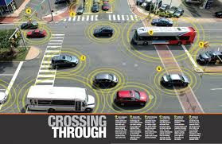
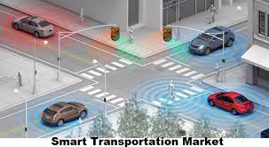
SMART TRANSPORTATION

Slide 6
Intelligent Transport Technologies
Wireless Inductive Loop Communications Detection & Sensing Technologies
Video Vehicle Computational Detection Technologies
Floating Car Data/Floating Cellular Data

Slide 7
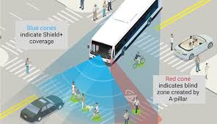
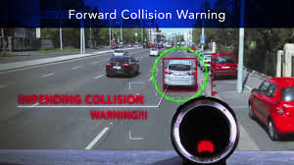

Slide 8
Smart Transport Applications:
Emergency Vehicle Notification Systems
Automatic Road Enforcement
Variable Speed Limits
Collision Avoidance Systems
Dynamic Traffic Light Sequence

Slide 9
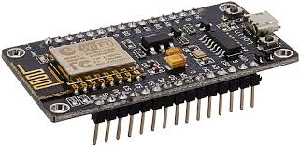
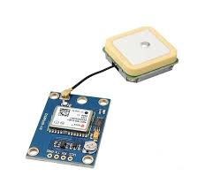
Components
Hardware
Node MCU
GPS Module
Software
Arduino IDE
IBM Cloud
MIT App Inventor2

Slide 10

THANK YOU

